Slide 1
Exploring TCAS II
Group 5: Ahmed Ben Sidhom, Paul Maienza, Jacob Boyle, Alexander Goldbacher, Harrison Tashjian, Zachary Keyek

Slide 2
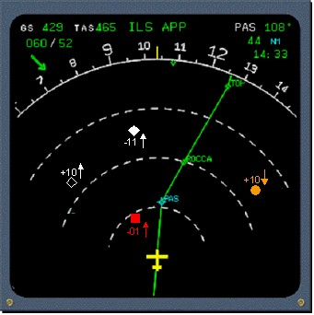
What is TCAS II?
Definition – TCAS II stands for Traffic Alert and Collision Avoidance System II
Purpose
Reduce the Risk of Mid-Air Collisions
Provide Collision Avoidance independent of ATC
Coordinate with other TCAS-II Equipped Aircrafts using Traffic Advisories (TAs) and Resolution Advisories (RAs)
Image of TCAS II Display
Reference Source: Introduction to TCAS II by the Federal Aviation Administration (FAA), dated February 28, 2011
Notes:
Info from pg 5-6 in “Introduction to TCAS II”

Slide 3
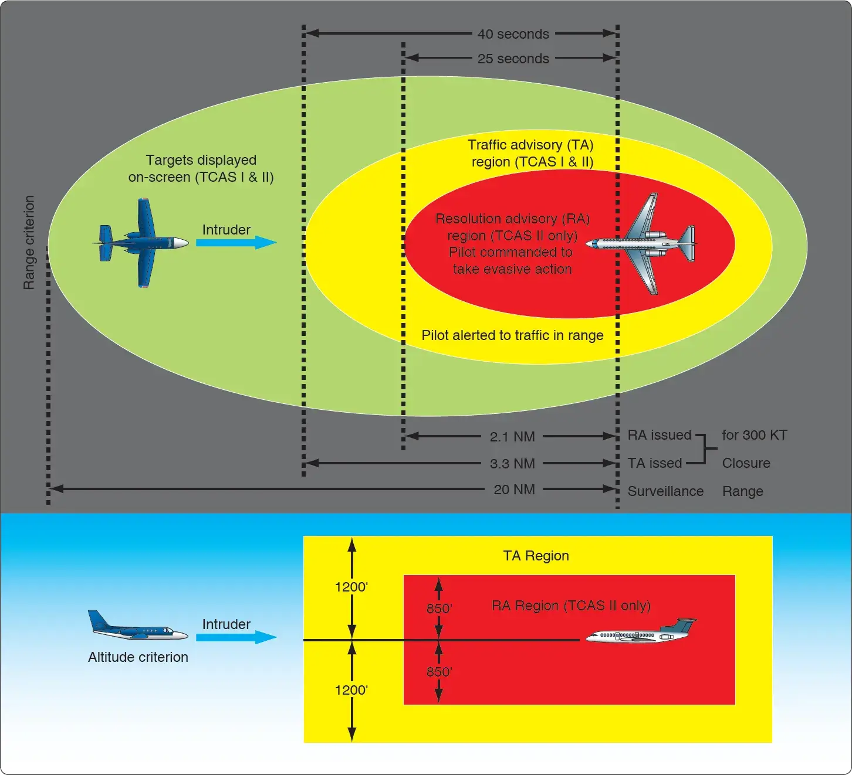
Significance of TCAS II
Enhances Aviation Safety by reduction of mid-air collision risk
Allows correction independent of ATC (Air Traffic Control)
Brings an element of communication between aircrafts by using TAs and RAs (Traffic Advisories, Resolution Advisories)
Balance of reactive and proactive
Example of standardization of aircraft equipment
Reduces chance of human error through automatic collision avoidance
Figure 2: Diagram of the TCAS ll [2]

Slide 4
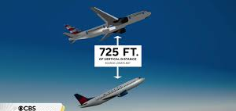
Key Features of TCAS II
Early Collision Avoidance Systems
Spurred by the 1956 collision over the Grand Canyon
Originally were passive, non-cooperative systems.
Closest point of approach
Tau
Variable (seconds)
Used in TCAS II as the time for closest point of approach.
Used for measurements for when TA’s and RA’s should be given.
TAs / RAs
Traffic Advisories (TA) are warnings.
Resolution Advisories (RA) are actions or directions.
TA’s happen before RA’s.
Image of two planes following ALIM
Reference Source: Introduction to TCAS II by the Federal Aviation Administration (FAA), dated February 28, 2011
Notes:
Alex – Notes for myself (or whoever records this slide) → ta’s a warnings about treats posed by nearby aircrafts. RA’s are specific directions like “climb” or “level off” that the TCAS system gives in order to try and prevent a collision. “ALIM” in the image will be explained on the next slide.

Slide 5
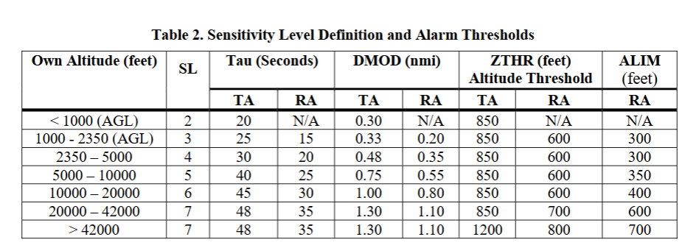
Key Features of TCAS II
Reference Source: Introduction to TCAS II by the Federal Aviation Administration (FAA), dated February 28, 2011
Notes:
Alex → This is the table, TAU is the closest point of approach time, SL is significance level, DMOD is distance modification. ZTHR is a fixed altitude threshold. ALIM is the desired vertical separation.

Slide 6
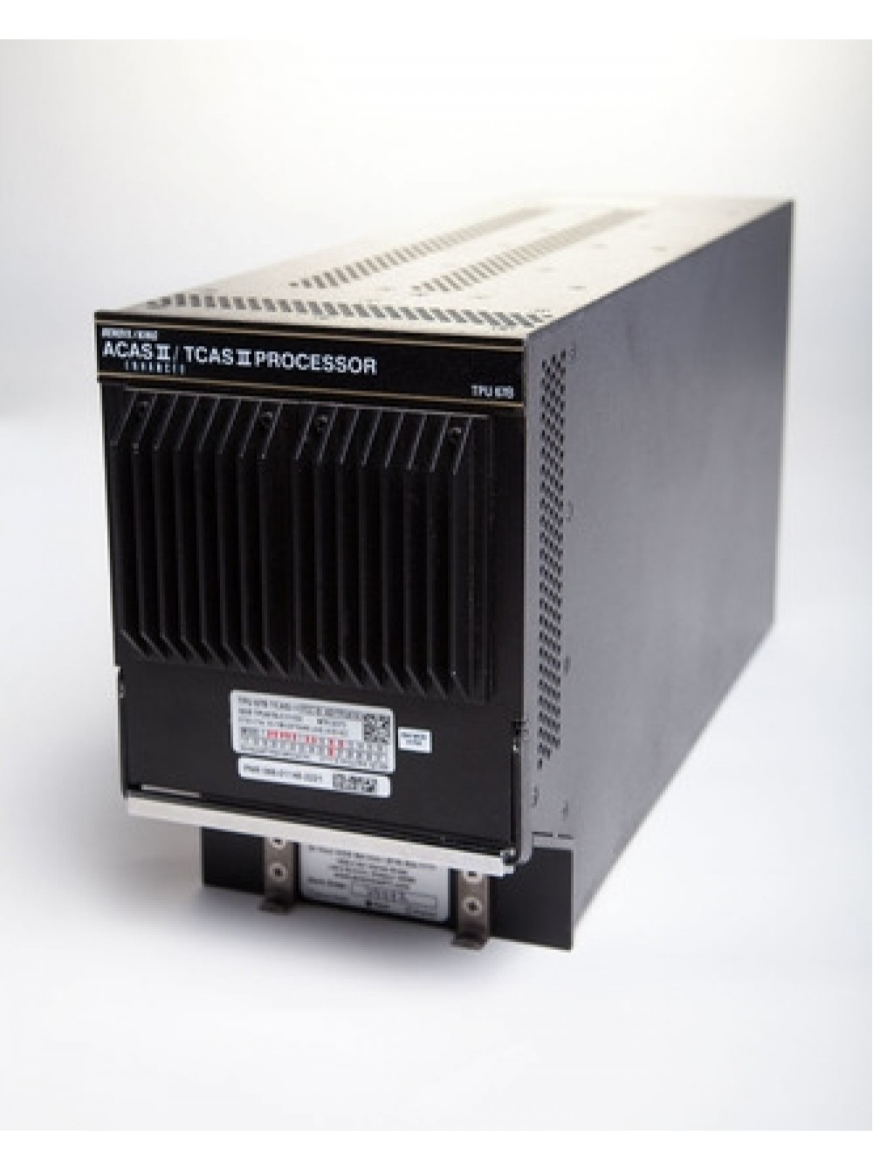
TCAS II Timeline
1981 - Congress mandates FAA to develop collision avoidance system
1986 - Mid -air collision prompts FAA to require TCAS II on some aircrafts
1989 - TCAS II 6.0 units were released
1993 - TCAS II 6.04a units were released
1999 - TCAS II 7.0 units were released
2008 - TCAS II 7.1 units were released
Image of TCAS II 7.1 Processor
Notes:
PM
INfo found in pg 6-9
wha

Slide 7


TCAS II Versions
Version 6.0
Triggered by 1986 mid-air collision over Cerritos, California between a DC-9 and a private aircraft
FAA mandated rule in 1989 that required TCAS II on passenger aircraft with more than 30 seats by end of 1991 (was extended to 1993)
TCAS Transition Program (TTP) began in late 1991 to do operational evaluations (in the US)
EUROCONTROL in Europe and JCAB Evaluations in Japan (other countries did evaluations as well)
Version 6.04a
Came from result of operational evaluations
Reduction of nuisance alerts occurring at low altitudes & during level off maneuvers
Correction of issue in altitude crossing logic
Notes:
Info from pg 8-9 in “Introduction to TCAS II”
PM

Slide 8
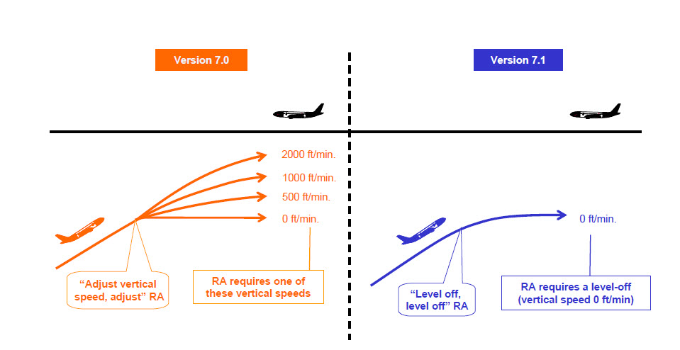
TCAS II Versions (cont.)
Version 7.0
Result of TTP evaluation of Version 6.04a
Indicated actual vertical displacement from RA response was often >300 feet and had adverse affect on controllers & the ATC system
Reduced the number of RAs
Minimize altitude displacement in response to RAs
Version 7.1
Result of EUROCONTROL evaluation of Version 7.0
Response to Near-miss in Japan (2001) and mid-air collision over Ueberlingen, Germany (2002)
Allowed additional sense reversal RAs to better handle vertical chase geometries
Replaced “Adjust Vertical Speed, Adjust” (AVSA) RAs with “Level Off, Level Off” (LOLO) to prevent pilots from increasing vertical rate incorrectly
Vision Representation of AVSA vs. LOLO
Notes:
Info from pg 8-9 in “Introduction to TCAS II”
PM

Slide 9
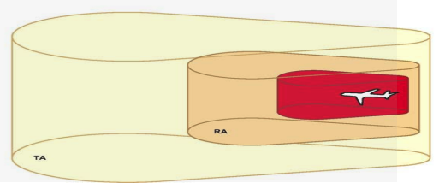
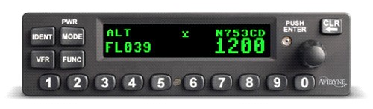
Shall Statements
The TCAS II system shall provide Traffic Advisories (TAs) and Resolution Advisories (RAs) in the vertical dimension to maintain or increase vertical separation between aircraft.
The TCAS II Computer Unit shall perform airspace surveillance, intruder tracking, own aircraft altitude tracking, threat detection, RA maneuver selection, and advisory generation.
The Mode S transponder shall be installed and operational for TCAS II to function.
TCAS II shall be capable of simultaneously tracking up to 30 transponder-equipped aircraft within a nominal range of 30 nautical miles.
The TCAS II logic shall use sensitivity levels to adjust the alerting thresholds based on the aircraft's altitude.
TCAS Protection Volume
Image of Mode S Transponder
Notes:
PM
–Shall statement 1 found on pg.5
–Shall statement 2 found on pg.11
–Shall statement 3 found on pg.11
–Shall statement 5 found on pg.17
–Shall statement 7 found on pg.22

Slide 10
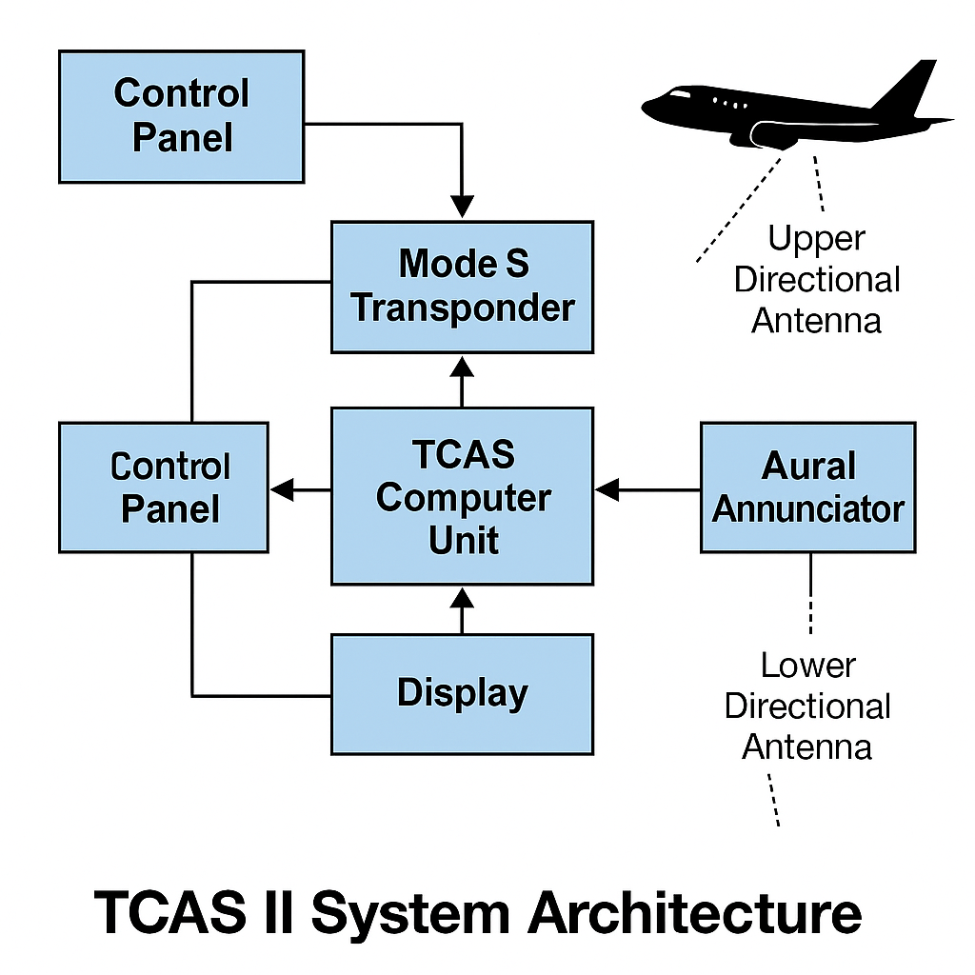
Test Plan: Demonstration of TCAS II
Ensure the TCAS panel is set correctly (Requirement 6 & 7)
Demonstration will be conducted in 3 interactive simulation stages:
CPA/TCPA Conflict Simulator
Adjust Latitude, Longitude, and Altitude of aircraft
Modify safety zone thresholds
Simulates predicted Closest Point of Approach (CPA) and Time to CPA (TCPA)
ADS-B Real-Time CPA/TCPA Viewer
View real-time aircraft positions from ADS-B data
Change CPA safety threshold and prediction time window
Highlights conflict warnings when thresholds are exceeded
RL Aircraft Real-Time Simulation
Animated intruder aircraft simulate dynamic conflict conditions
Reinforcement Learning agent adjusts trajectory to maintain safe separation

Slide 11
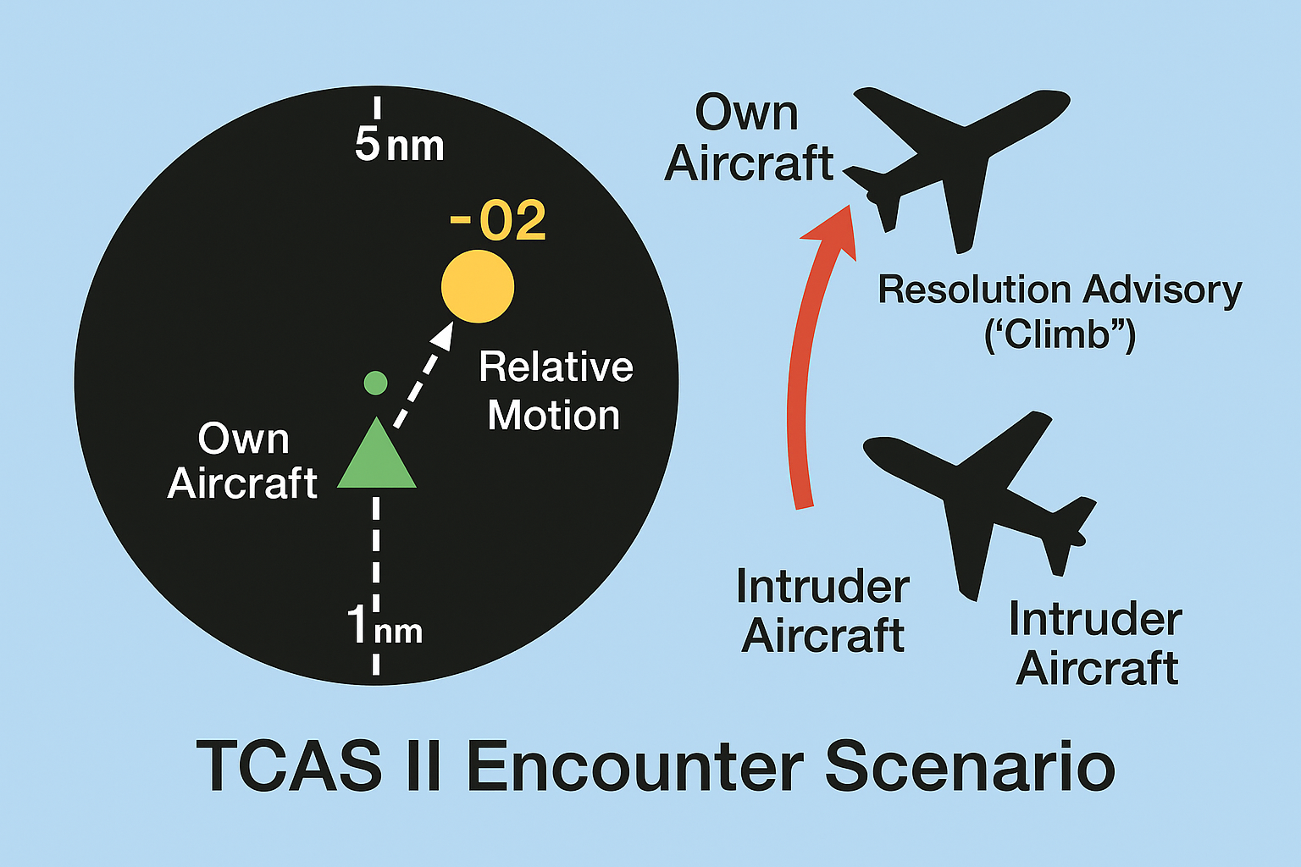
Detailed Test Procedure
Step 1: Check the TCAS panel is working properly
Step 2: Verify Mode S transponder functionality
Step 3: Launch CPA/TCPA Conflict Simulator
Adjust Lat/Long/Alt of multiple aircraft
Observe predicted CPA and TCPA
Step 4: Use ADS-B Viewer to simulate real-time airspace
Modify CPA threshold and monitor live aircraft interactions
Step 5: Activate RL Aircraft Simulation
Watch AI-controlled aircraft respond to intruder maneuvers
Observe if the system maintains safe CPA distance
Step 6: Compare alerts and avoidance maneuvers with TCAS II logic
Step 7: Document system behavior, response time, and any deviations

Slide 12
Test Methods
1 - Simulate equipment reliability through estimated MTBF qualified life in environment
2 - Use components that are rated for operation at temperatures of -20F to 120F
3 - Test CPA/TCPA logic by manually adjusting aircraft positions and observing predicted outputs
4 - Adjust ADS-B parameters and CPA thresholds to validate conflict detection accuracy
5 - Simulate animated intruders using RL to observe collision avoidance in real time
6 - Monitor vertical resolution advisories (e.g., “Level Off”) in response to CPA violations
7 - Evaluate system performance with multiple simultaneous intruders
8 - Log alert timing and ensure system meets response expectations
9 - Confirm TCAS goes into standby mode upon simulated Mode S transponder failure
10 - Simulate lightning strikes and follow IEEE 998-1996
11 - Compare RL actions to standard TCAS RA logic under similar conditions
12 - Verify alert clarity and correctness based on varying tau and threshold values

Slide 13
Simulation/Demonstration of TCAS II

Slide 14
Code Walkthrough & Demo Overview

Slide 15
Citations
[1] FAA, “TCAS II V7.1 Intro booklet,” 2011. Available: https://www.faa.gov/documentlibrary/media/advisory_circular/tcas%20ii%20v7.1%20intro%20booklet.pdf
[2] “On the Feasibility of Exploiting Traffic Collision Avoidance System Vulnerabilities.” Accessed: May 07, 2025. [Online]. Available: https://beerkay.github.io/papers/Berkay2020TCASCNS.pdf
[3] NBAA, “Traffic Alert and Collision Avoidance System (TCAS) | NBAA - National Business Aviation Association,” NBAA - National Business Aviation Association, 2019. https://nbaa.org/aircraft-operations/communications-navigation-surveillance-cns/tcas/
[4] P. Berges and J. Reed, “Exploring the Vulnerabilities of Traffic Collision Avoidance Systems (TCAS) Through Software Defined Radio (SDR) Exploitation,” 2019. Available: https://vtechworks.lib.vt.edu/server/api/core/bitstreams/6872fd9a-63d4-4be8-b94e-10d4cebf55cb/content
[5] “Technology,” www.aopa.org, Sep. 07, 2020. https://www.aopa.org/training-and-safety/online-learning/safety-spotlights/collision-avoidance/technology
[6] “Ttr 4100 Tcas Ii,” ‎@CollinsAero, 2025. https://www.collinsaerospace.com/what-we-do/industries/business-aviation/flight-deck/additional-flight-deck/traffic-awareness/ttr-4100-tcas-ii (accessed May 07, 2025).
[7] “Part II Implementing TCAS.” Accessed: May 07, 2025. [Online]. Available: https://www.princeton.edu/~ota/disk1/1989/8929/892905.PDF
[8] W. Harman, “TCAS: A System for Preventing Midair Collisions.” Available: https://www.ll.mit.edu/sites/default/files/publication/doc/tcas-system-preventing-midair-collisions-harman-ja-6399.pdf
[9] “safety - How does TCAS work?,” Aviation Stack Exchange. https://aviation.stackexchange.com/questions/1883/how-does-tcas-work

